Slide 1
CISC108
Introduction to Computer Science
[TA Name]
[TA Name]
University of Delaware
Week 9 - Time/While

Slide 2
[TA Name]
[TA Name]
[TA Photo]
[TA Photo]

Slide 3

Today’s Plan
Think up questions with your group
TAs answer questions

Slide 4
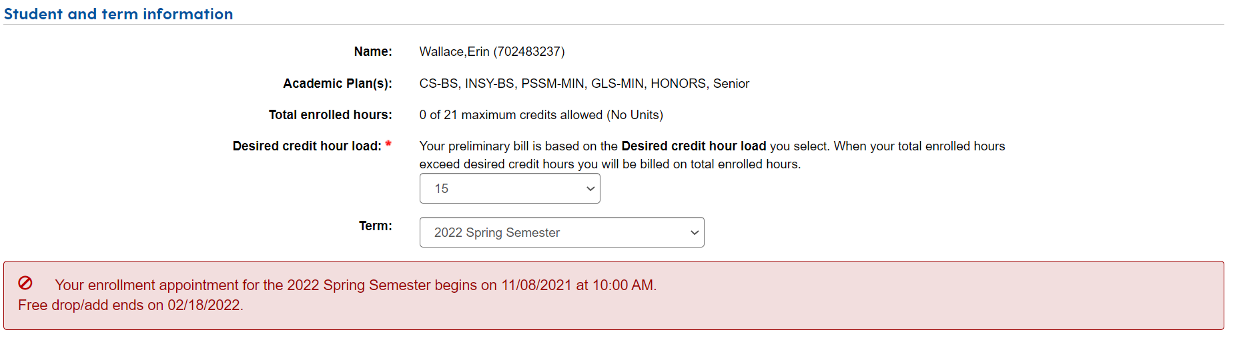
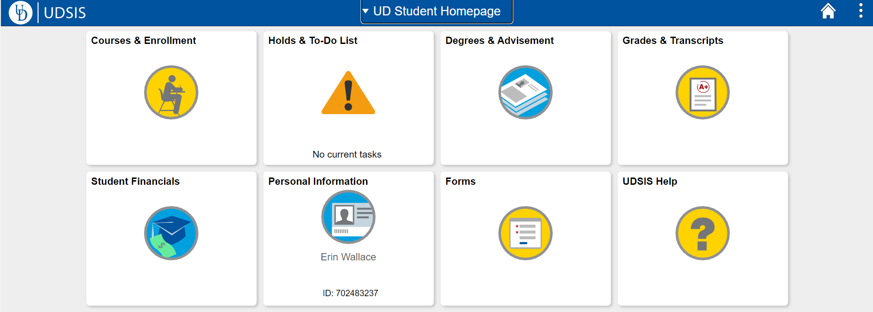
Course Registration
See your registration time on https://my.udel.edu/task/all/webreg
You can see which courses you’ve taken/need to take on UDSIS>Degrees & Advisement>Degree Audit
You can make a sample schedule ahead of time with BlueHen Planner (linked from your WebReg page)
Bring specific questions to your advisor! Make sure you have searched for answers on your own.

Slide 5
Concentrations
Artificial Intelligence and Robotics
Bioinformatics
Cybersecurity
Data Science
High-Performance Computing
Networks and Systems
Theory
General CS
Create your own!
Notes:
If it seems relevant, tell that story about a student who created their own japanese game design concentration → took japanese language courses, art courses, some other stuff, got hired by nintendo
Usually have to select concentration by end of sophomore year, but you can start taking yoru technical electives earlier if you meet the prerequisites and want to get a head start!

Slide 6
Tips and Tricks for the Major from Past TAs
Math minor is only one more class than CS Major requirements
Cognitive Science and Computer Science have a lot of overlap, you can double major
Geology is a really cool (and easy!) science class!!
You get some free Coursera classes with your UD email! Take advantage of learning something outside of class if you want
Start your github page!! Add project to it for a portfolio, helps with jobs and such (or another version of a personal website)
UDSIS (the system) is always right over your advisor
If you are interested in the bioinformatics concentration, take your science classes early!

Slide 7
Opportunities
Undergrad (*non-majors too)
Internship*
Externship
Research lab*
Part-time job*
Teaching Assistant*
Lab Assistant*
Tutor
CPUs
Clubs/RSOs*
Post-Grad
Masters degree
PhD
Consultant
Analyst
Software Engineer
IT Department
Project Manager
Cybersecurity Specialist
Professor or Teacher
Web Developer
Database Administrator
Network architect
Quality Tester
4+1 Masters Program

Slide 8
Job Hunt
Make sure your resume is in a standard format (job board auto-readers will filter yours out if you don’t do this!)
Clean up your LinkedIn profile
Practice your “elevator pitch,” 30-60 second intro about yourself to use in networking situations
Apply, apply, apply! Don’t be afraid to put yourself out there--the worst that can happen is you get a “no,” the best is you get a job!
It is just as important to learn what you don’t like!! It’s ok if your first job/internship isn’t your favorite
Practice behavioral interview questions so you are comfortable answering on the fly
Use practice questions to prepare for technical interviews
Get used to explaining your thinking out loud as you work through problems so recruiters understand your logic (just as important, if not more so, than having correct syntax)
Learn how to tell a story with your resume/application
Take your high school off your resume after Sophomore year
Link your github and/or linkedIn to your resume

Slide 9
Advice!!
Be careful with your time! Don’t sign up for too many things that you end up wasting it. Find balance in your schedule
Learn new things and try building stuff outside of class!
CISC electives are a great way to see what direction you may want to take after college
Make friends in the major! It helps having people around you that understand the course load and industry
Start the career search early! You don’t have to overdo it, but lots of companies have early career opportunities which are great for making connections
Talk to professors! Go to Office Hours!
No one knows what is going on, so ask for help if you need it
Plan you classes ahead (3 or 4 semesters, or until graduation) so that you can see where you have space to take electives. Knock out the requirements first if you can
Having an internship/job you don’t like is almost as important as finding one you do. Being able to eliminate an industry/role from your search early on will help you succeed later

Slide 10
FAQs
Are CISC classes hard? What are some of the harder classes you’ve taken?
Where can I find internship opportunities?
What is the difference between CS BS, CS BA, INSY?
When do I select my concentration?
When/how should I apply for internships?
How do I know what classes I need to take?
Notes:
I would make a point to say that while students are free to apply to internships their freshman year, most employers are looking for candidates with a bit more skill and they will have a better chance applying their sophomore year. It never hurts to try, you could always get a ‘Yes’
If you are applying to the CISC department from a different department, put your request in early. Requests will only get approved twice a year (August and January, I think). It is becoming a pretty selective process so make sure to do as well as you can in your CISC classes!
UD Catalog/Degree audit will tell you what classes you need to take. You have flexibility on when to take them but UD CISC department page has a suggested timeline somewhere on their website. Do what works for you, don’t take too many technical courses one semester if you know that will fry your brain--spread them out if you can.
Contact your advisor for registration questions or Samantha Fowle.
Pick your concentration/minor based off what you are genuinely interested in!! You will spend lost of time in that area and if you have a passion/interest you will do better. You will also be able to speak to it better in interview and your passion will come across well. Employers want motivated people that will work hard so sometimes adding a minor that is not CS related will work in your favor because it could (1) set you up to do CS work in a cool industry or (2) will show a different side of you and help you connect with recruiters/interviewers.

Slide 11
Helpful links
UDSIS
UD Catalog
CIS Undergrad Program Extra Information
Concentrations overview
Handshake (use your UD credentials)
Resume Templates
Registration FAQs
Example technical practice questions
Coursera
Tableau
UD CISC Dept FAQ
Study Abroad: check out the different programs

Slide 12
CISC108
Have a great day!
Don’t forget:
Need to finish module 9 this week!
Need to read Primer 10 before next lab!
See ya!

